Slide 1

WIPRO NGA Program – 25SUB4530_CP_JAVA
Capstone Project Presentation – 9th Feb & 10th Feb 2026
Project Title - Insurance Policy Management System
Presented by - SHAIK HAASIF & SHREE SHANKAR
Team Number : 18
www.rpsconsulting.in

Slide 2

Agenda
Introduction
Problem Statement
Objectives
Core Functionalities
Technology Stack
System Architecture
Module Workflow
Database Schema
Validation & Exception Flow
Deployment
Project Outcomes
2024 - RPS Consulting all rights reserved

Slide 3
Introduction & Problem Statement
The Insurance Policy Management System is a comprehensive web-based platform designed to transform traditional insurance operations. It serves as a centralized solution for managing the entire policy lifecycle, from initial creation and customer enrollment to renewal, claim processing, and final expiration. The system bridges the gap between insurance providers, agents, and customers through an intuitive interface and robust backend services.
Problem Statement:
Manual Processes:
High error rates in data entry
Delays in policy issuance and renewals
Difficulty in tracking policy status
Lack of Transparency:
Customers cannot easily check their policy status
No real-time updates on claims processing
Limited visibility into premium calculations
Inefficient Customer Service:
Long response times for queries
No self-service options for customers
Difficulty in managing customer portfolios
Scalability Issues:
Manual systems cannot handle growing customer bases
Limited reporting and analytics capabilities
Security concerns with physical document storage
2024 - RPS Consulting all rights reserved

Slide 4
Objective
The primary objectives of this project are to achieve complete digital transformation of insurance policy management by eliminating paper-based processes and automating workflows from policy creation to claims settlement.
We aim to significantly enhance operational efficiency by reducing processing times and minimizing human error. The system is designed to improve the customer experience through self-service portals and real-time tracking, while ensuring robust data security and regulatory compliance.
Furthermore, we have built the platform with scalability in mind, ensuring it can handle a growing user base and increasing data volume with high performance and availability.
2024 - RPS Consulting all rights reserved

Slide 5
Core Functionality
The system delivers comprehensive functionality across all aspects of insurance management, from customer onboarding to claims settlement. Each module is designed with user experience in mind, providing intuitive interfaces for different user roles while maintaining data integrity and security throughout all operations.
Functional Modules:
Policy Management
Customer Management
Claims Processing
Agent Dashboard
Reporting & Analytics
2024 - RPS Consulting all rights reserved

Slide 6
Technology Stack
We have employed a modern, robust technology stack that ensures optimal performance, scalability, and maintainability. The choice of technologies reflects industry best practices and provides a solid foundation for future enhancements while addressing current business requirements effectively.
Technology Components:
Frontend: Angular 16+ and Bootstrap 5
Backend: Spring Boot
Database: SQL
DevOps: Docker, Azure App Service, GitHub Actions
2024 - RPS Consulting all rights reserved

Slide 7
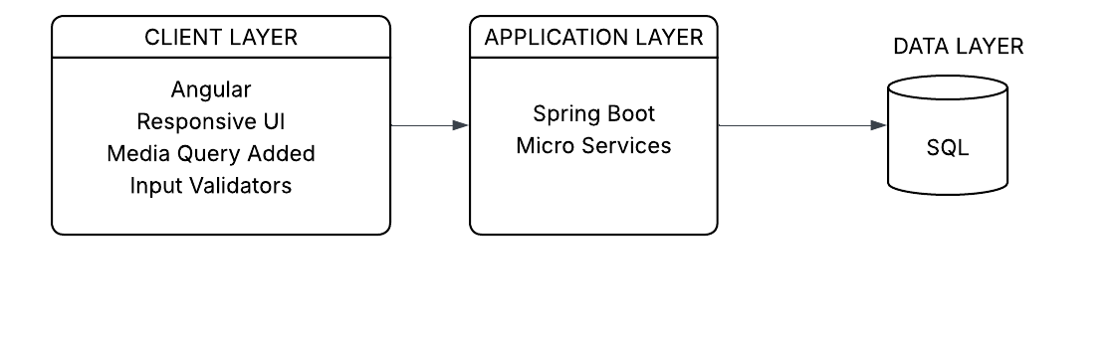
System Architecture Diagram
2024 - RPS Consulting all rights reserved

Slide 8
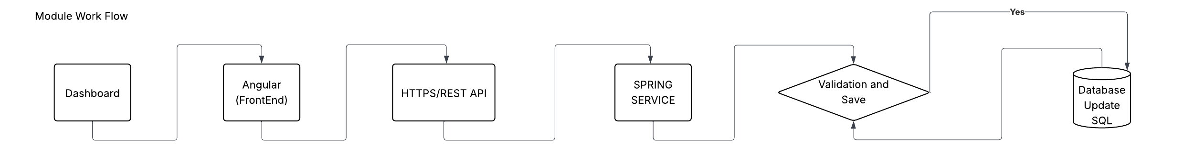
Module Workflow
2024 - RPS Consulting all rights reserved

Slide 9
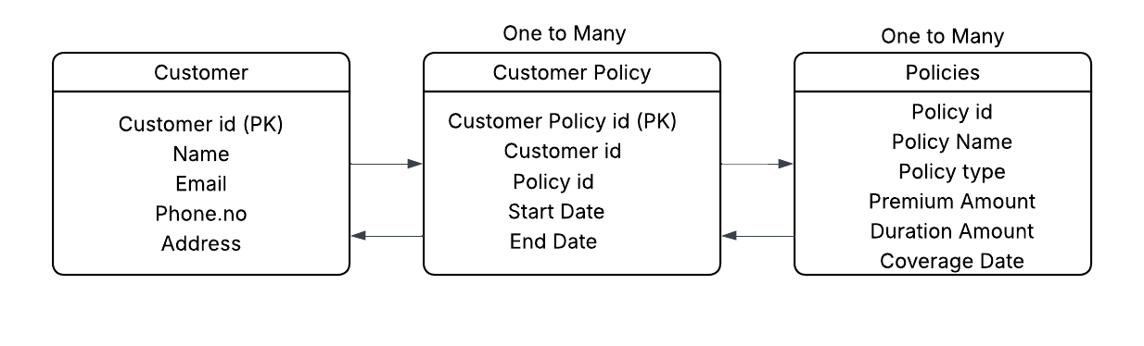
Database Schema
Our database schema is built around core entities including Customers, Policies, Claims, Agents, and Payments, with carefully defined relationships to ensure data integrity and support business operations. The Customer table stores personal and KYC details, linking to multiple Policies through a one-to-many relationship. Each Policy can have multiple Claims, and each Claim is tied to a specific Policy. Agents are associated with the policies they manage, and Payments track all financial transactions. The schema is normalized to third normal form and includes strategic indexing on frequently queried fields to optimize performance for complex queries and reporting needs.
2024 - RPS Consulting all rights reserved

Slide 10
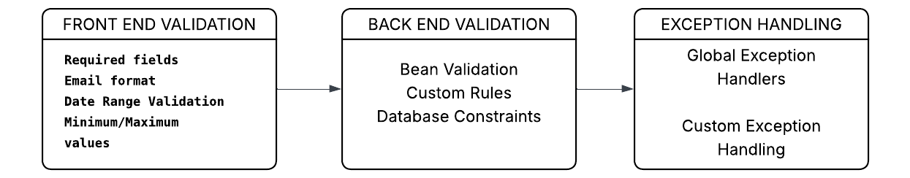
Validation & Exception Flow
Our implementation features a sophisticated multi-tier validation framework and comprehensive exception handling system that ensures data integrity, business rule compliance, and user-friendly error reporting.
At the frontend, Angular Reactive Forms with custom validators provide immediate feedback to users, while backend validations in Spring Boot enforce complex business rules through Bean Validation annotations and programmatic checks.
Database-level constraints serve as the final safeguard against invalid data persistence.
The exception handling architecture utilizes Spring's @ControllerAdvice pattern to provide consistent, structured error responses across all API endpoints, with detailed logging for debugging and audit purposes.
2024 - RPS Consulting all rights reserved

Slide 11
Deployment
Our deployment strategy leverages a modern approach using Docker for containerization and Microsoft Azure for cloud infrastructure, ensuring a scalable, reliable, and maintainable production environment.
We have implemented and deployed in Git Lab with a complete CI/CD pipeline using GitHub Actions that automates the build, test, and deployment processes, enabling rapid and error-free releases.
The application is deployed as containerized microservices on Azure App Service, with Azure Database for SQL handling persistent data storage.
This cloud-native architecture supports auto-scaling, high availability, and disaster recovery while providing comprehensive monitoring through Azure Application Insights.
2024 - RPS Consulting all rights reserved

Slide 12
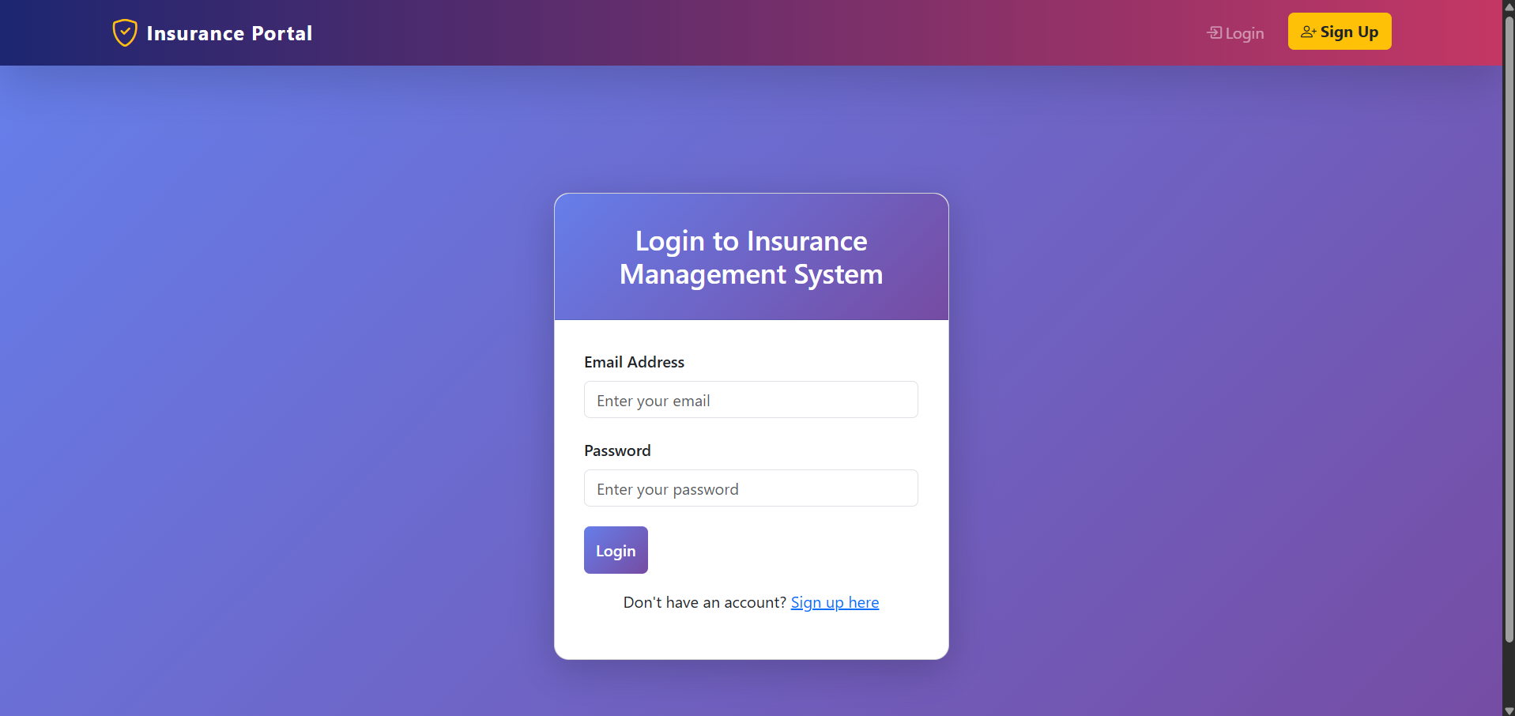
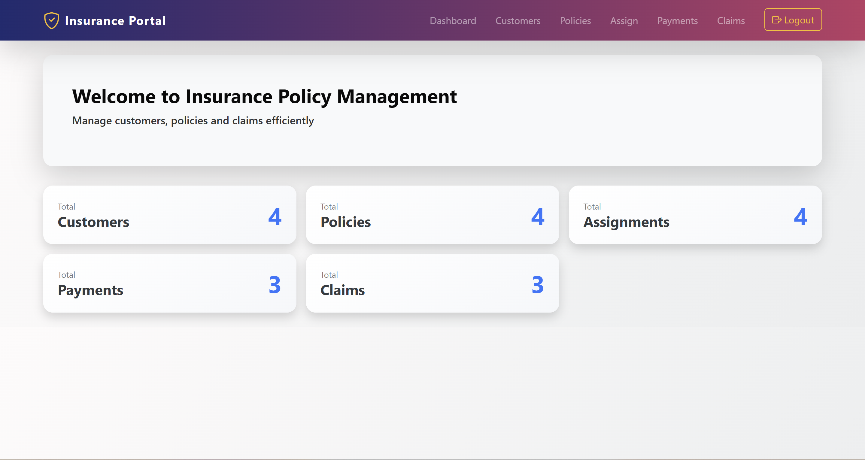
Project Outcome
Frontend :
Login Page
Home Page
2024 - RPS Consulting all rights reserved

Slide 13
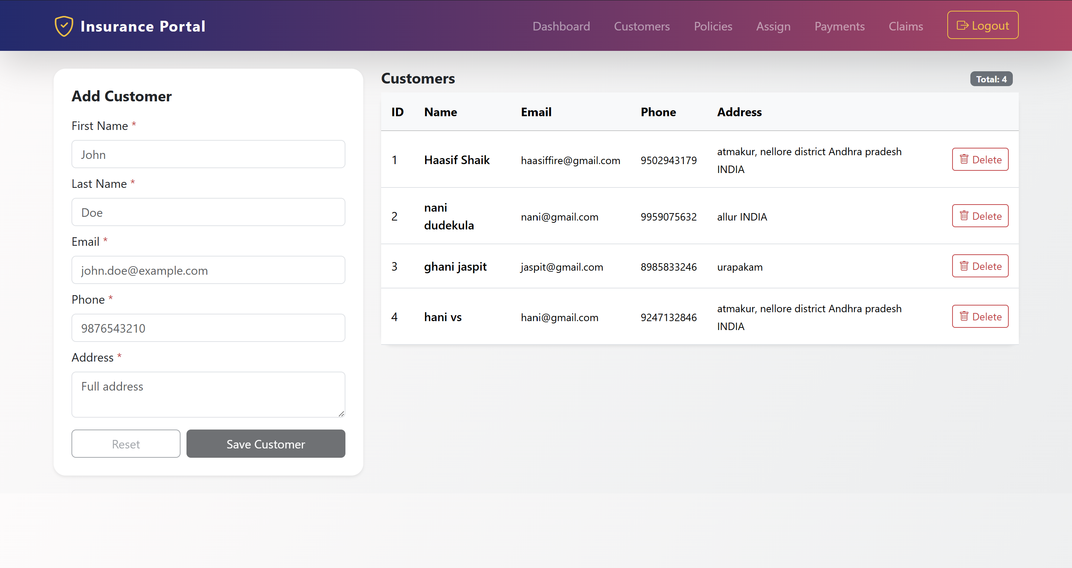
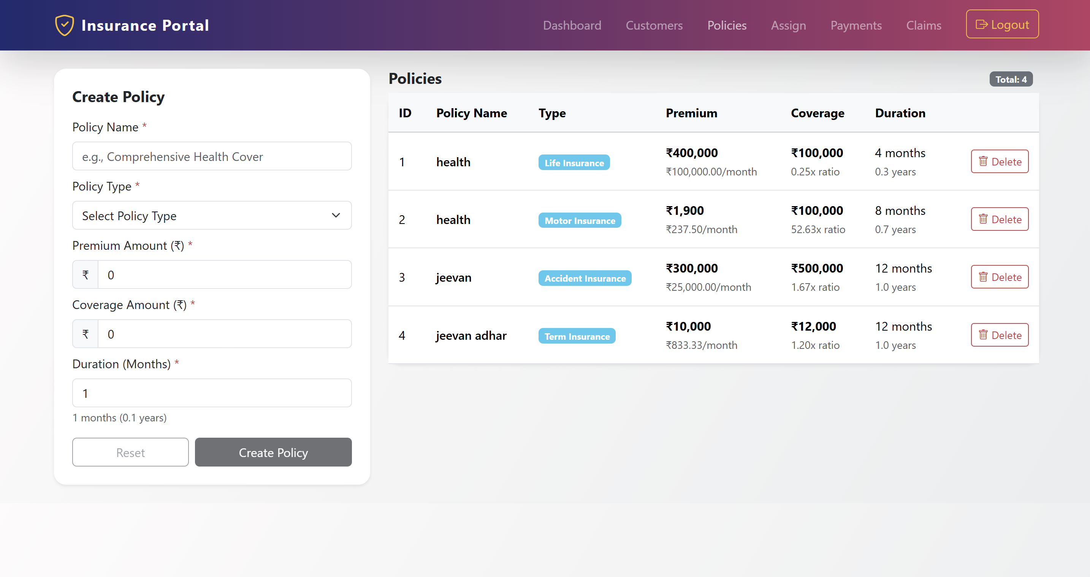
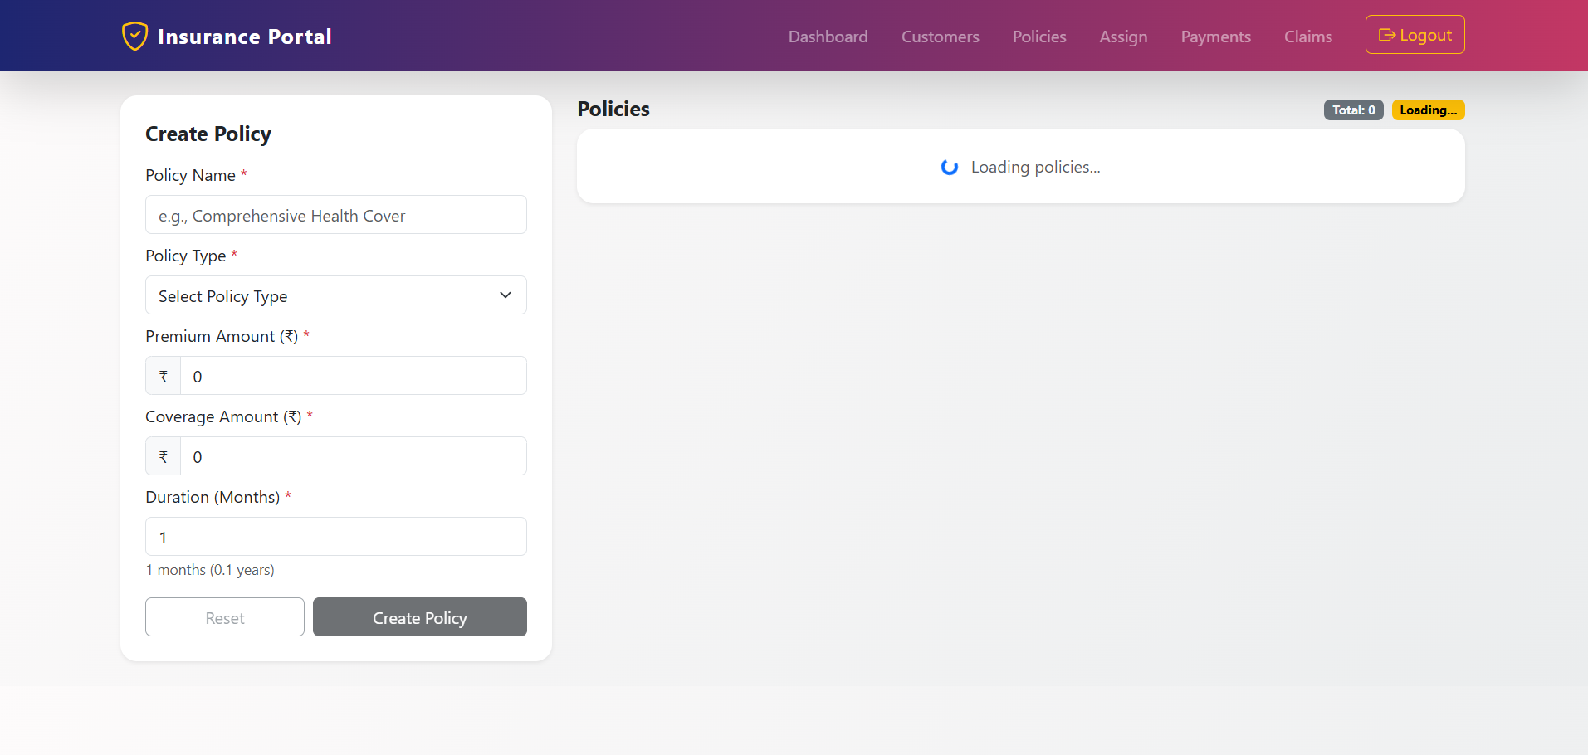
Project Outcome
Frontend :
Customers Page
Policies Page
2024 - RPS Consulting all rights reserved

Slide 14
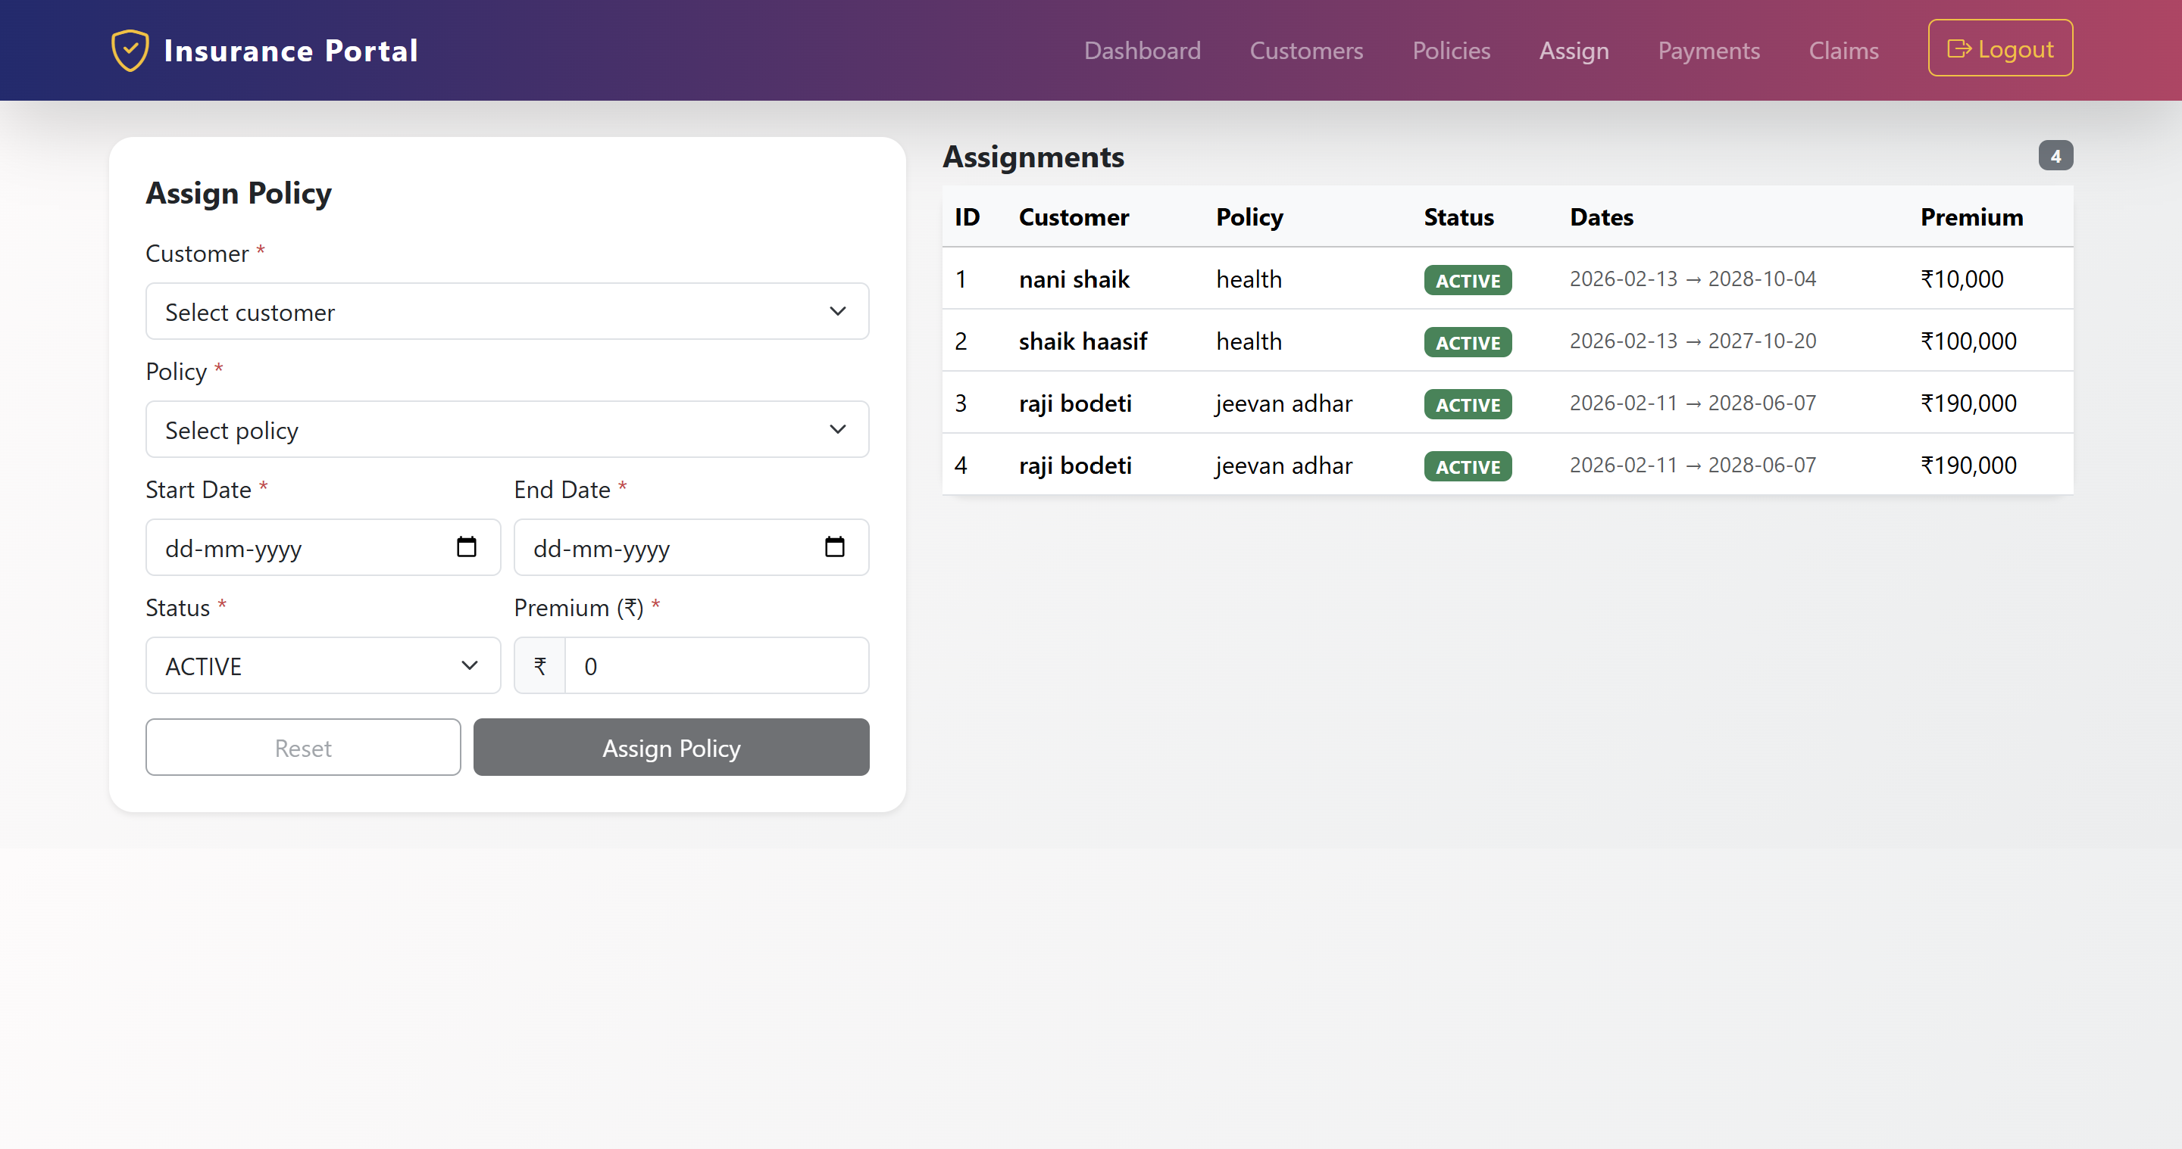
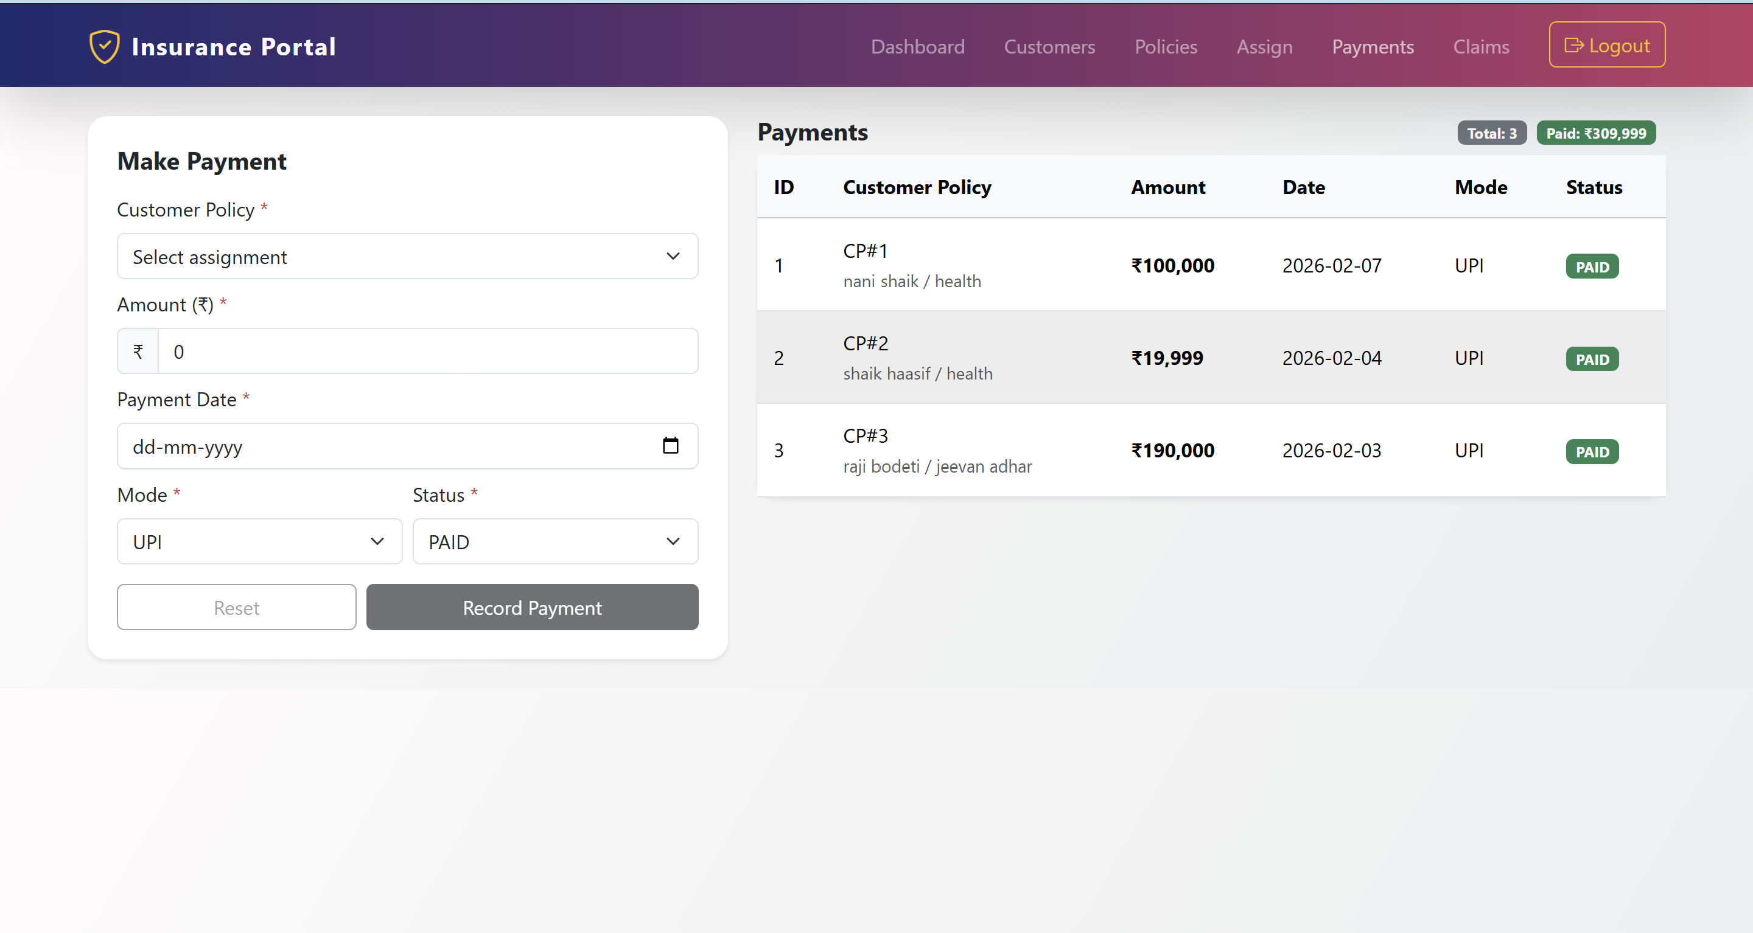
Project Outcome
Frontend :
Assign Policy Page
Payments Page
2024 - RPS Consulting all rights reserved

Slide 15
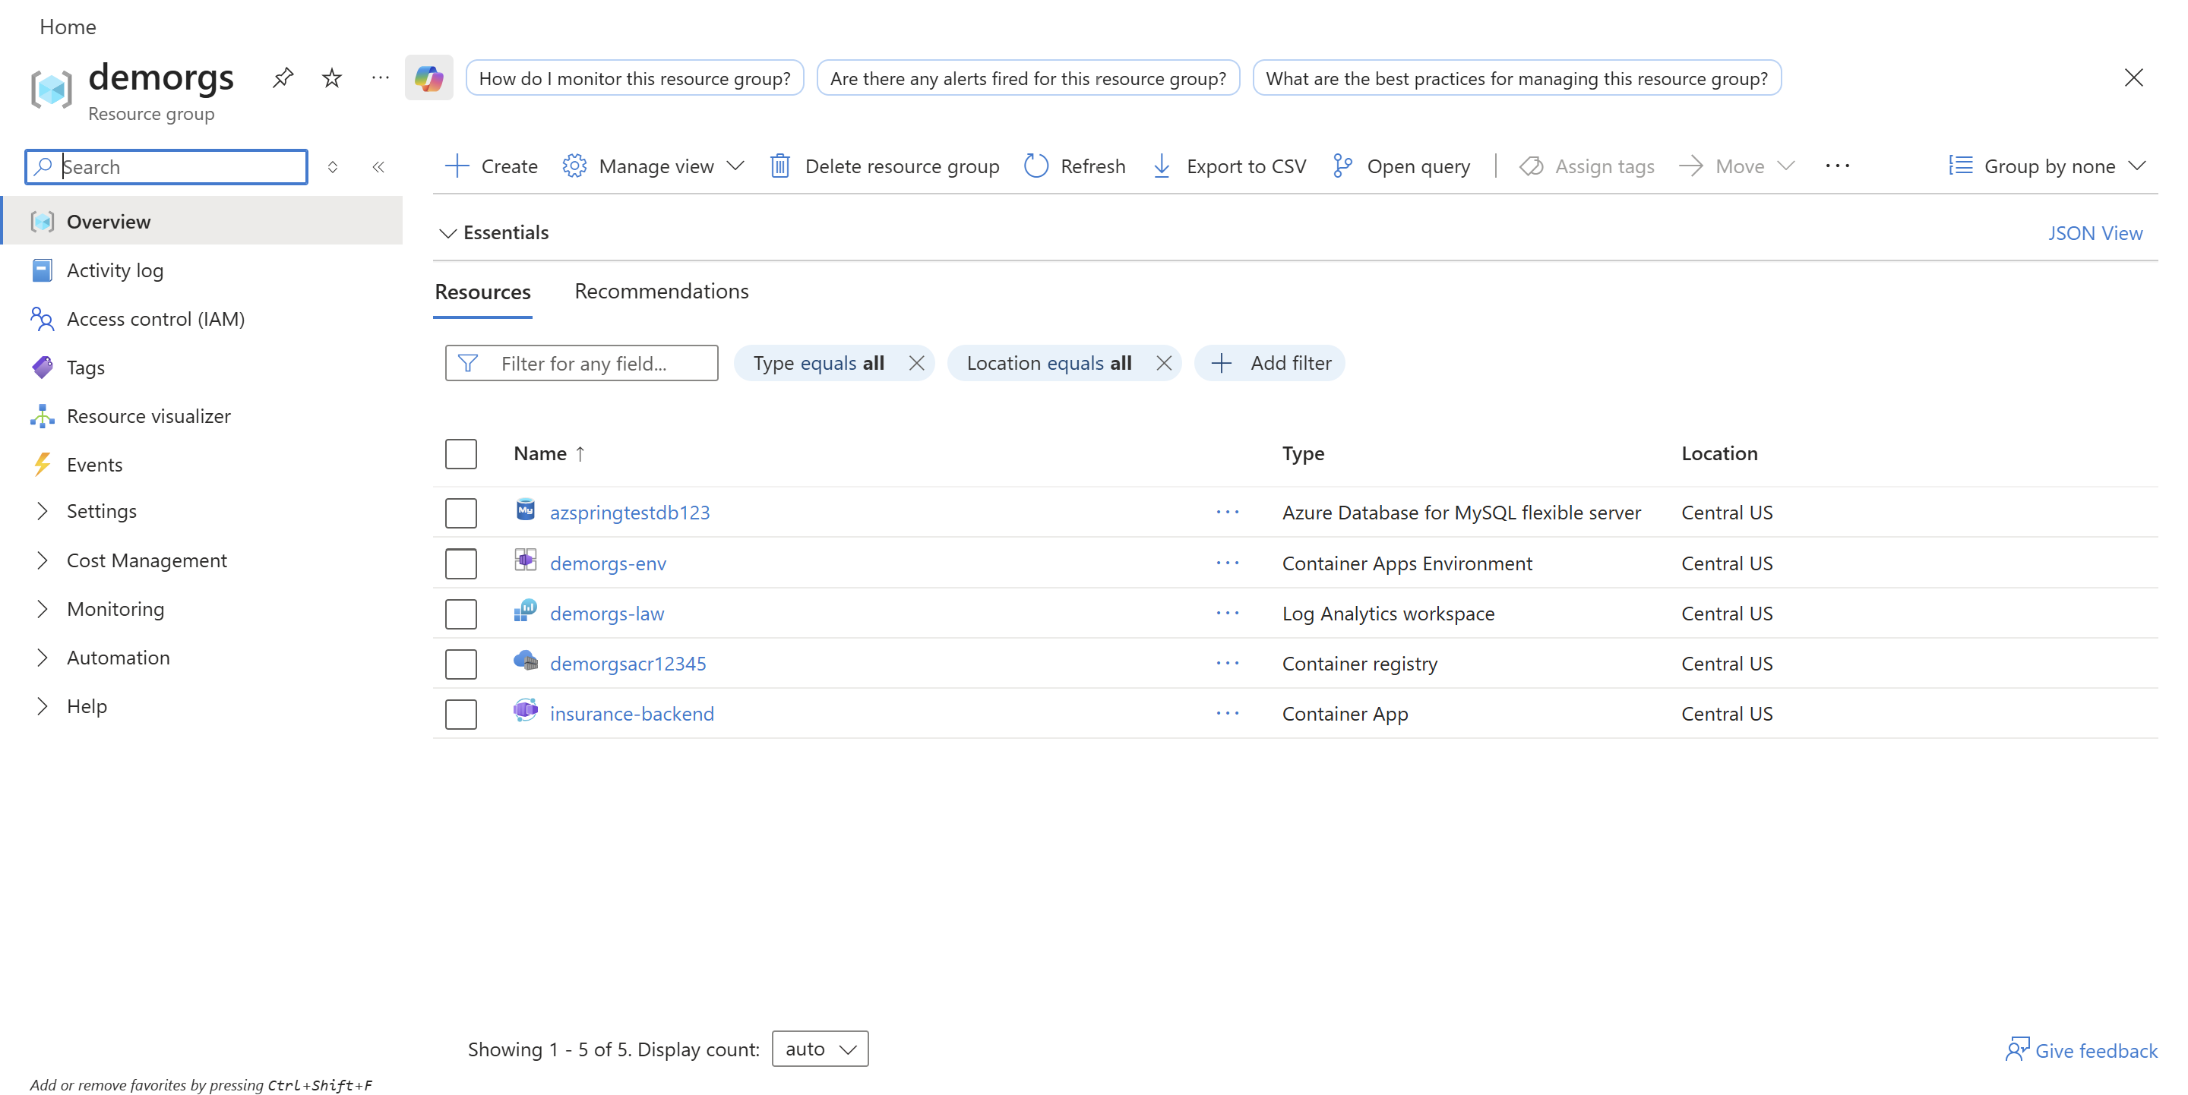
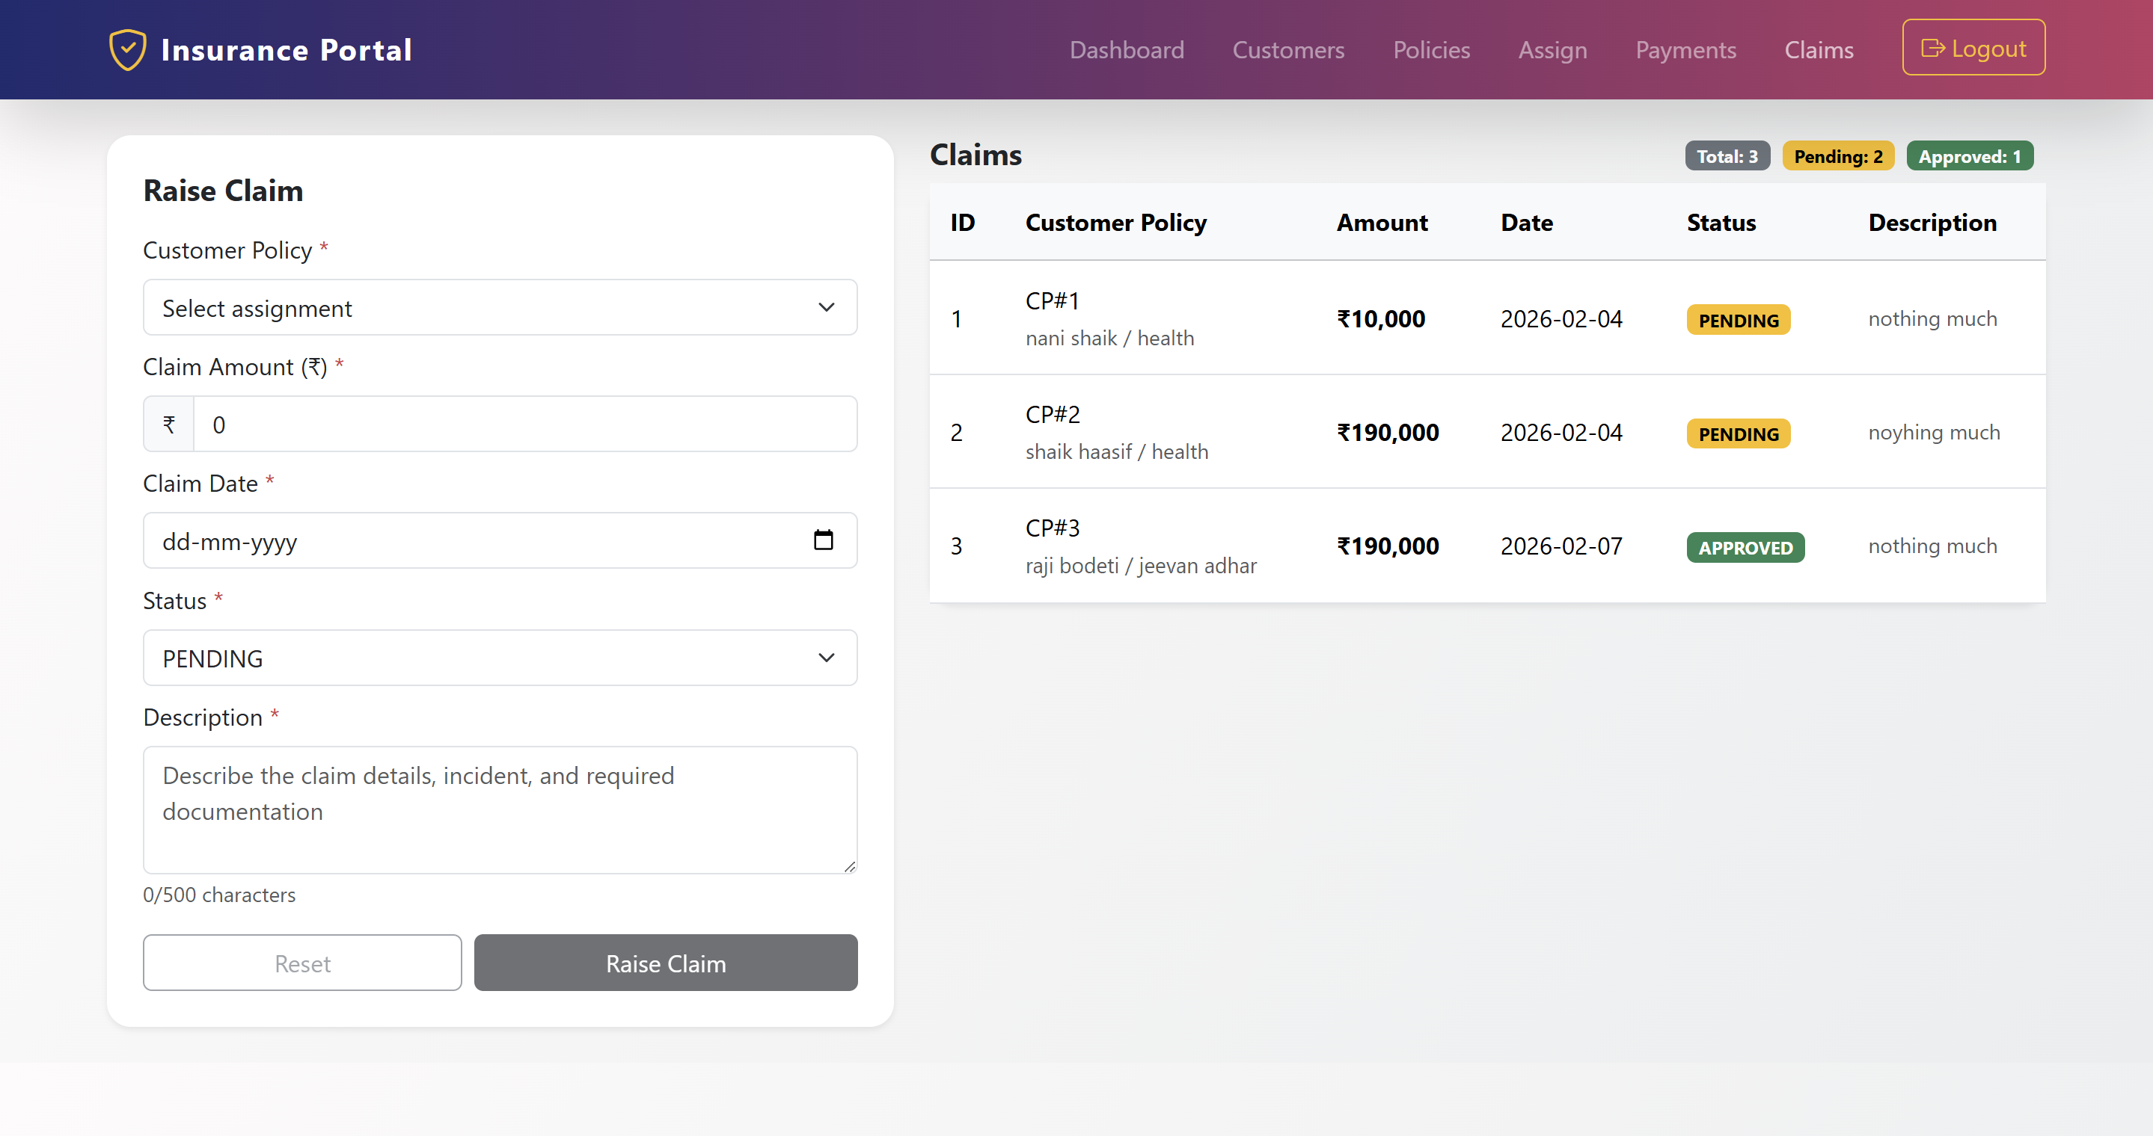
Raise Claim
Azure Database Created

Slide 16
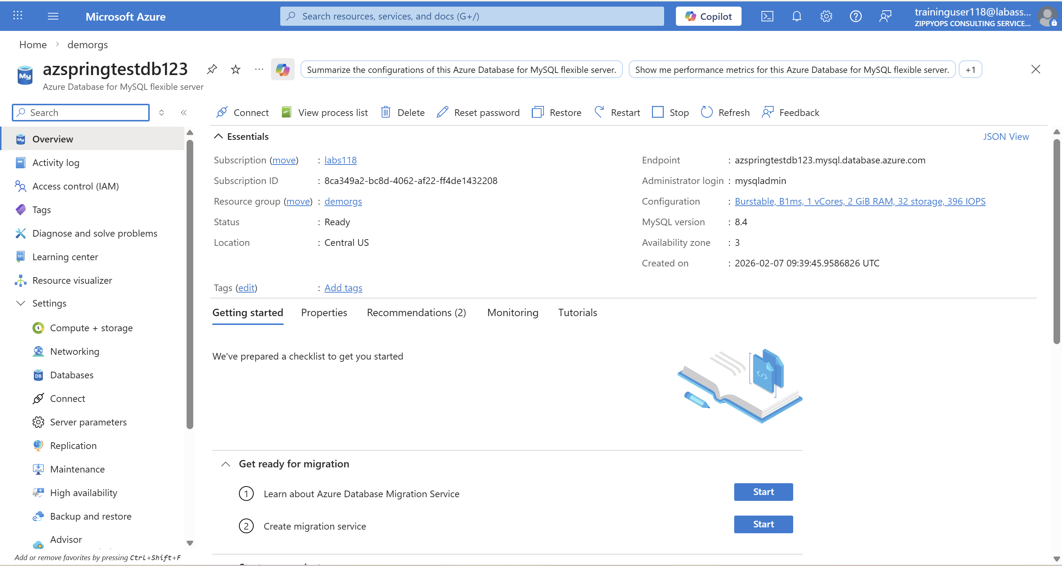
Azure Database for MySQL flexible server

Slide 17
Thank You
2024 - RPS Consulting all rights reserved

